Slide 1


PRAGMA 21 Worshop
VAST’s GeoGrid IT Infrastructure Research and Solution Proposal
Dao Van Tuyet, Nguyen Van Thuong
Nguyen Thanh Tung,Vu Duc Thi.
Vietnam Academy of Science and Technology
,
Sapporo, 17 Oct 2011

Slide 2
Outline
1
Background
2
Grid enabled Geoinformatics
3
VAST IOIT/ IAMI visit AIST/ ITRI for training
4
Discussion and Conclusion

Slide 3
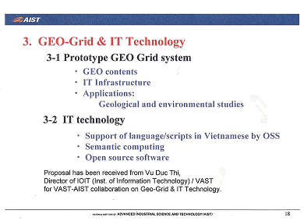
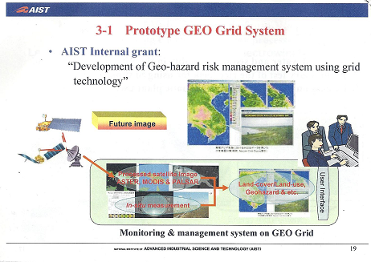
BACKGROUND
+ VAST-AIST workshop in HCM city 2009
+ PRAGMA 17 + GEO Grid WS, Oct 2009 in Hanoi.
+ AIST endorsed VAST-IOIT’s Grid proposal by Prof. Vu Duc Thi .

Slide 4
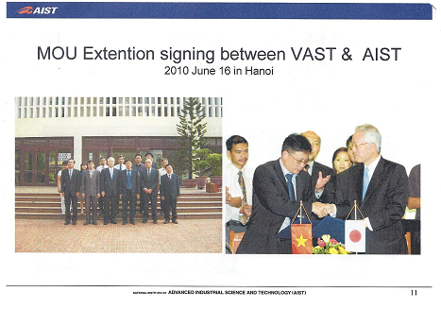
BACKGROUND
+ Signing Ceremony, June 2010 in Hanoi
+ AIST proposal accepted by MEXT, Japan
+ JRA :” Implementation and evaluation of GEO Grid Infrastructure in Vietnam , Nov 2010

Slide 5
Overview – ASIA GEO Grid Initiative Project Formation
PRAGMA, OGC, OGF
NIES, Japan
AsiaFlux Network
NSTDA/ NECTEC, Thailand’
Promotion of collaboration with ThaiFlux
Development of “Information Grid” and “Enviroment
AIST, Japan
NARL/NCHC, Taiwan
1. Development of near-real-time pipeline for processing satellite images to support in-situ image data to disaster prevention center
Support TaiwanFlux to provide Flux data by GEOGrid middleware
VAST, Vietnam
1. Development of GEO Grid Infrastructure in Vietnam
2. Understanding Physics, Mathematics used in weather research and firecasting model
3. Evaluation of Asia GEO Grid Infrastruture

Slide 6
Overview – IAMI e- Infrastructure
Grid site(s) using gLite:
Keylab site (3CPUs / 6Servers - certified) http://goc.grid.sinica.edu.tw/gstat/VN-IOIT-KEYLAB/
CNRS site (2CPUs / 6Servers - connect to VinaREN network)

Slide 7
Activities (2/3)
connected institution
SN | Institutes / Universities / Hospitals | Contact persons
1 | Institute of Chemistry Technology - Vietnam | Dr. Nguyen Cuu Khoa
2 | Institute of Geography and Natural Resources - HCM City Viet Nam | Dr. Le Ngoc Thanh
3 | HCMC University Medical Center - Vietnam | Dr. Tran Thanh Xuan
4 | Pasteur Institute HCM City | Dr. Vu Thi Que Huong

Slide 8
Main Support Roles
HCMC University Medical Center – Vietnam:
Research about Ophthamology using HOPE on the Grid System
Co-Support Organization: HealthGrid – Celermont ferrand (France)
Contact person:
Dr. Tran Anh Tuan - dr.trananhtuan@gmail.com
IAMI’s Researcher : Nguyễn Thanh Tùng – tungnt@vast-hcm.ac.vn
Pasteur Institute HCM City – ARBOVIRUT LABO
Using GVSS Tool to do research on Dengue Fever NS3
Design and implement the system to manage the samples for ARBOVIRUS LABO
Building the database for saving and presenting the Influenza Virus A H5N1, H1N1
Co-support Organization: Institute of Sinica (Taiwan)
Contact persons:
Dr.Vu Thi Que Huong - quehuong@pasteur-hcm.org
Dr.Huynh Chuong - huynh@bioinfohelpdesk.org
IAMI’s Researcher: Nguyễn Thanh Tùng – tungnt@vast-hcm.ac.vn

Slide 9
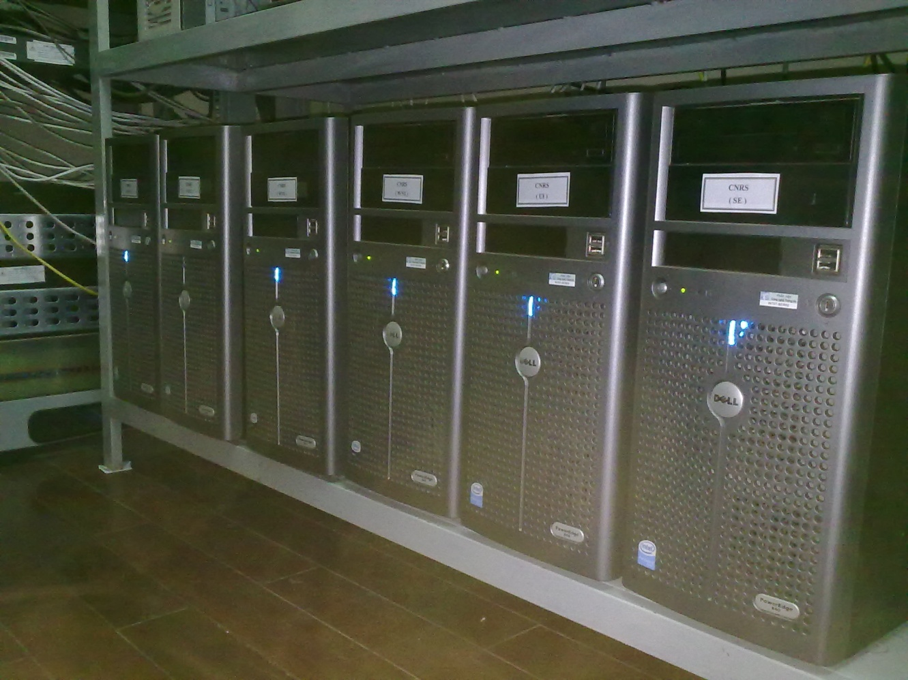
HOPE – Platform (3/3)
IAMI has built and succesfully implemented one CNRS Grid site with 6 servers.
HOPE has been implemented on UI server and ready for connection at link: http://ui.iami.vngrid.vinaren.vn:8080/gridsphere/

Slide 10
HOPE – Platform (3/3)
Information | UI | CE | SE
 | IP: 119.18.139.135 SubMask: 255.255.255.128 Gateway: 119.18.139.129 DNS: 202.179.241.65 Host: ui.iami.vngrid.vinaren.vn Manufacturer: DELL Hostcert: Sinica – Taiwan | IP: 119.18.139.132 SubMask: 255.255.255.128 Gateway: 119.18.139.129 DNS: 202.179.241.65 Host: ce.iami.vngrid.vinaren.vn Manufacturer: DELL Hostcert: Sinica – Taiwan | IP: 119.18.139.136 SubMask: 255.255.255.128 Gateway: 119.18.139.129 DNS: 202.179.241.65 Host: se.iami.vngrid.vinaren.vn Manufacturer: DELL Hostcert: Sinica – Taiwan
 | LFC | WN1 | WN2
 | IP: 119.18.139.131 SubMask: 255.255.255.128 Gateway: 119.18.139.129 DNS: 202.179.241.65 Host: lfc.iami.vngrid.vinaren.vn Manufacturer: DELL Hostcert: Sinica – Taiwan | IP: 119.18.139.133 SubMask: 255.255.255.128 Gateway: 119.18.139.129 DNS: 202.179.241.65 Host: wn1.iami.vngrid.vinaren.vn Manufacturer: DELL | IP: 119.18.139.134 SubMask: 255.255.255.128 Gateway: 119.18.139.129 DNS: 202.179.241.65 Host: wn2.iami.vngrid.vinaren.vn Manufacturer: DELL
apps | HOPE BioInformatics
note | Using IP VinaREN Connect to GRID2-FR Participate Biomed VO

Slide 11
Outline
1
Background
2
Grid enabled GeoInformatics
3
VAST IOIT/ IAMI visit AIST/ ITRI for training
4
Discussion and Conclusion

Slide 12
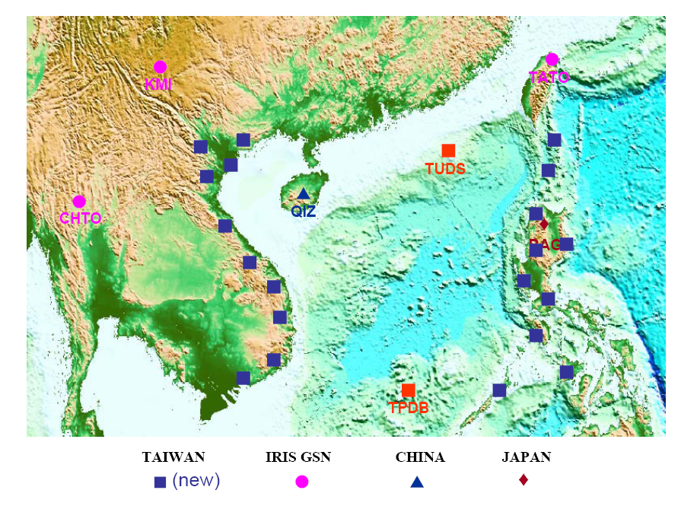
Earthquake research, monitor, hazard reduction
■
Notes:
Two purposes: 1. tectonic structure of SCS, 2. Fast report or warring for tsunami of SCS earthquakes.
Deploy status: 2008

Slide 13
IES2008
Earthquake research, monitor, hazard reduction

Slide 14
AIST- VAST GEO Grid Initiative Project:
Some activities in Vietnam
1.Development of GEO Grid Infrastructure in Vietnam
2.Understanding Physics, Mathematics used in weather research and forecasting model.
3.Evaluation of Asia GEO Grid Infrastructure.

Slide 15
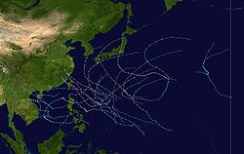
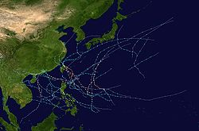
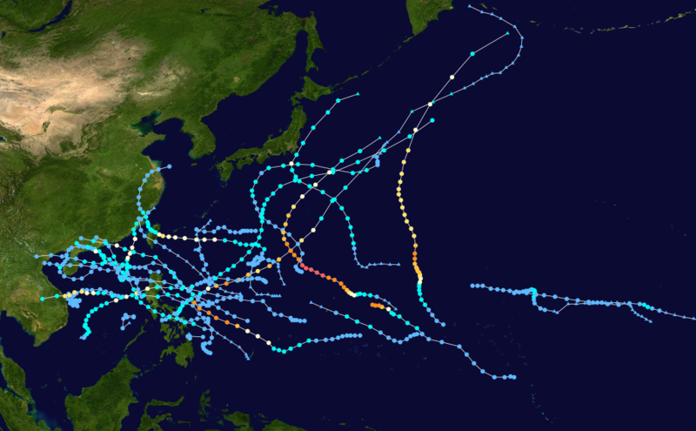
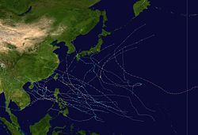
Summary of the 2006 - 2009 Pacific typhoon seasons
2008
2007
2009
2006

Slide 16
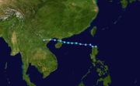
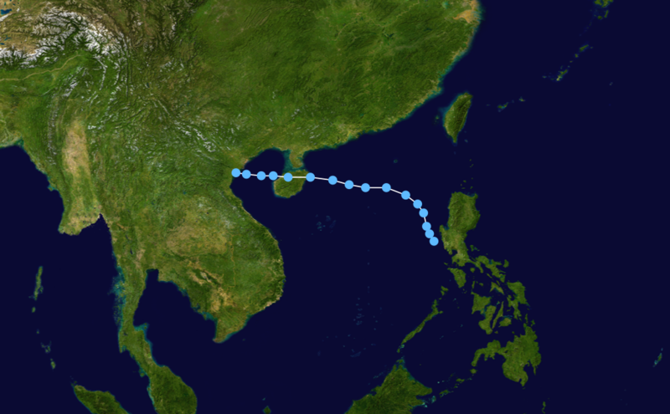
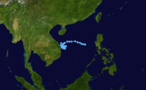
Vietnam 2009 typhoon season
Viet Nam is amongst the most disaster prone countries of the world
Tropical Storm Soudelor
July 9-11
massive floods
houses are destroyed and many
more damaged
damage to housing and
infrastructure
losses to agriculture and fisheries
loss of life
Tropical depression
September 4-9
Tropical Storm Mujigae
September 8

Slide 17
Tropical Storm Soudelor (July 11, 2009)
International designation: 0905; Higgest winds 65 km/hr
JTWC designation: 05W; Lowest pressure 992 mbar
PAGASA designation: Gorio
4,000 fishing vessels were ordered to return to port.
Up to 200 volunteers were mobilized to deal with damages from the storm
Officials evacuated people from 297 residences to higher grounds and reported that
977 other homes were in threatened areas.
Roughly VND71 billion (US$3.98 million) was set aside by the Government of Vietnam
to assist residents in natural disasters, including Soudelor.
An estimated 5,000 sandbags and 1,000 cubic meters of canvas were distributed to flood-prone areas.
The remnants of Soudelor produced widespread torrential rains in Northern Vietnam on July 13. Rainfall
totals peaked at 250 mm (9.8 in) in the region.Heavy rainfall, amounting to 130 mm (5.1 in), was also
recorded in Hanoi. The capital city experienced flash flooding, inundating numerous streets and buildings.
Two men were killed by lightning strikes associated with the storm. Officials reported that at least 13 large
trees had been downed by high winds. Flood waters in the hardest-hit areas reached a depth of 0.35 m.
One person was killed after being swept away.
A tornado also touched down during the storm, destroying the roofs of three homes. Thousands of hectares
of croplands were inundated by flood waters. Following the storm, 1,000 tonnes of rice was allocated for
victims of the floods.

Slide 18
Sequential procedure to detect the typhoon beginning
Main problem is formulation of the criterions that explain the laws of the typhoon origin.
Typhoon category
1.0
0.9
0.8
0.7
0.6
0.5
0.4
0.3
0.2
0.1
0.0
5
4
3
2
1
Storm
Indicator value (Relative units)
Tropical
Depression
Background zone
Running time

Slide 19
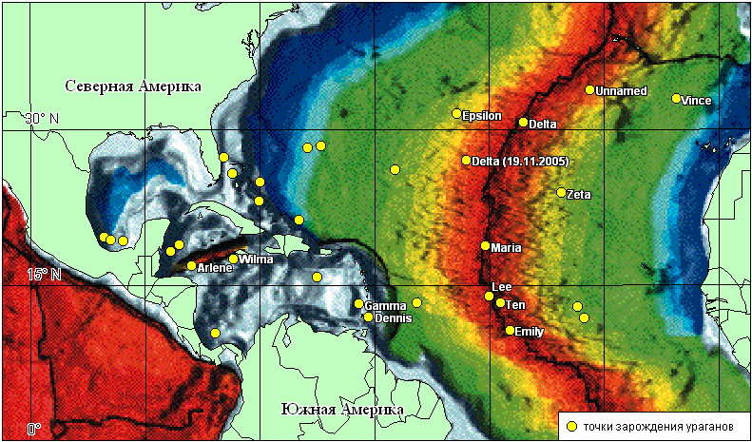
Oceanic water temperature < 27°C
North America
South America
Point of the hurricane origin
2005: 5 tropical depressions from 31 were formed under the ocean water temperature less 27°C and 10 from them were formed in the regions of active tectonism.

Slide 20
Temperature as Indicator of Tropical Cyclone Origin
North-West of the Pacific Ocean
Atlantic Ocean
Temperature
Temperature
North-East of the Pacific Ocean
Northern Indian Ocean
Temperature
Temperature

Slide 21
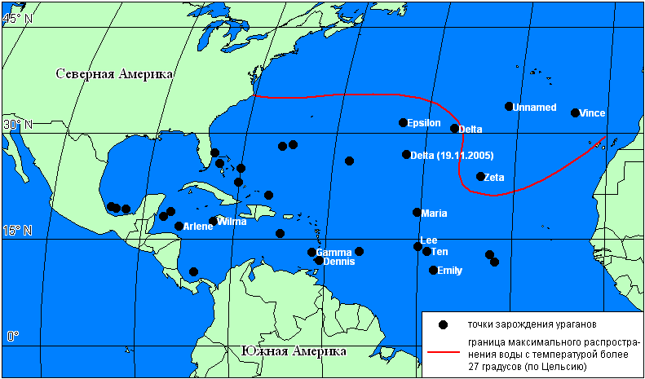
Atlantic hurricane season and ocean water temperature
T < 27°C
North America
T≥27°C
Place where hurricane was began in 2005.
South America

Slide 22
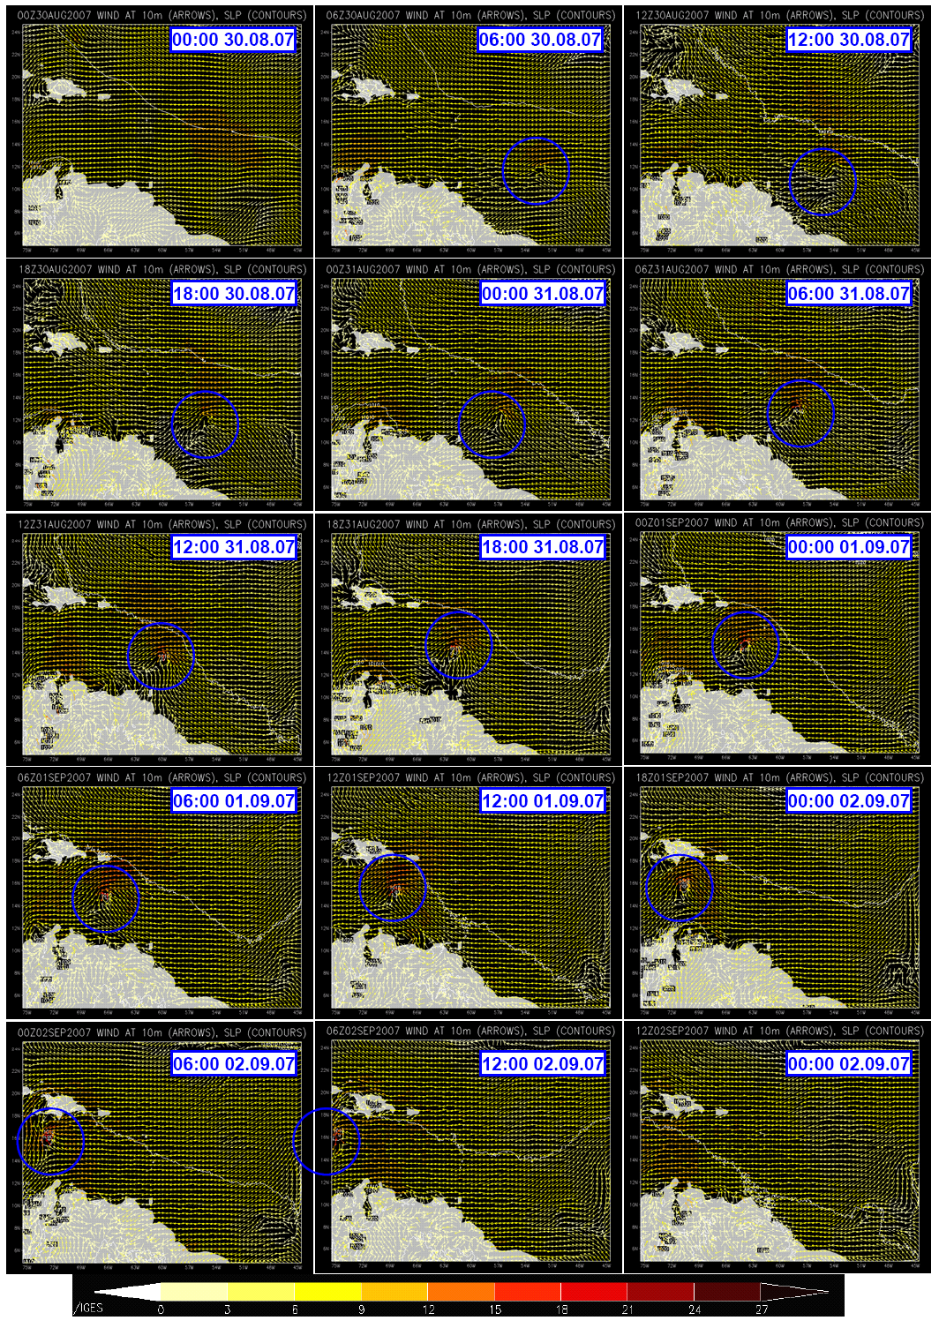
6-hourly snapshots of the wind speed in 6-km resolution of prognostic system WRF (Weather Research and Forecasting) simulation of hurricane Dean starting from 00:00 30.08.2007 to 00:00 02.09.2007.
Trajectory of the hurricane Dean during the Hurricane season of 2007. red dots correspond to the category 5 stage.

Slide 23
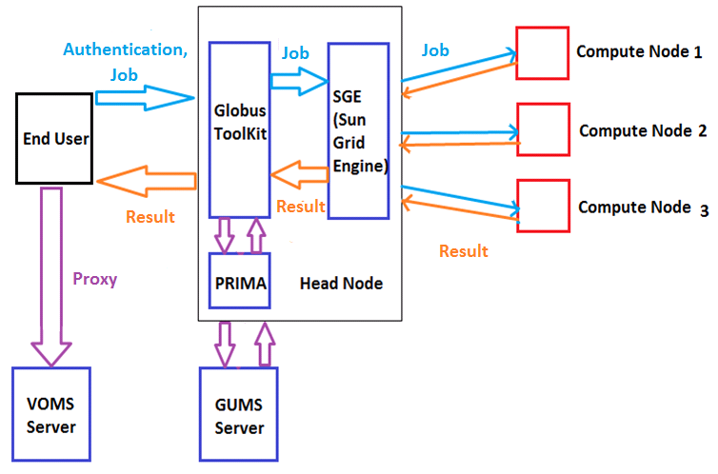
WRF4G

Slide 24
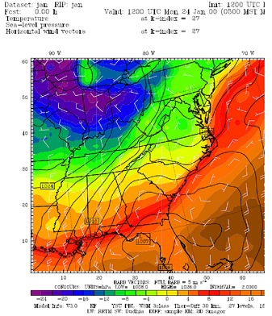
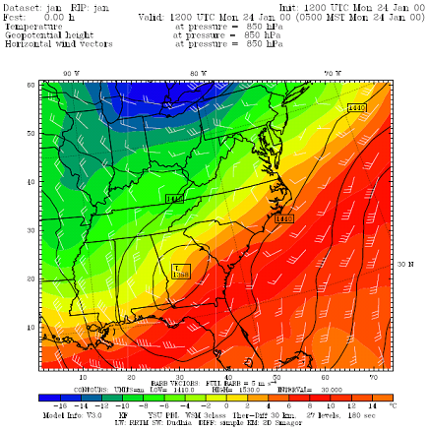
WRF4G

Slide 25
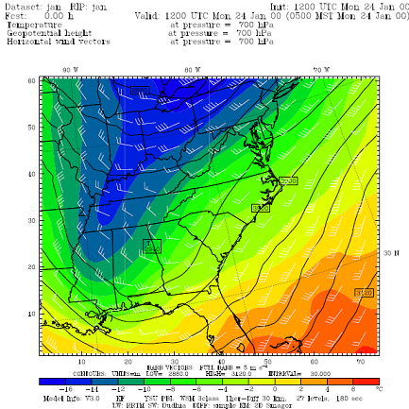
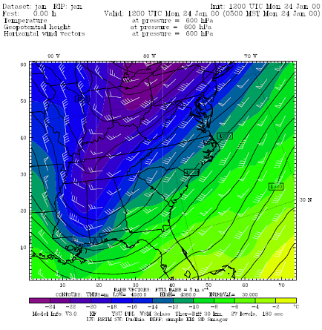
WRF4G

Slide 26
WRF4G FUTURE PLAN AT IAMI/ VAST
WRF4G is a part of the WRF Modeling System to GRID environments
It consists of slight modification to the WRF source + a set of wrapper scripts to interact with the GRID
A set of user scripts permits a flexible design of experiments consisting of realizations which can span different physics/parameters and/or a sequence of independent hindcasts

Slide 27
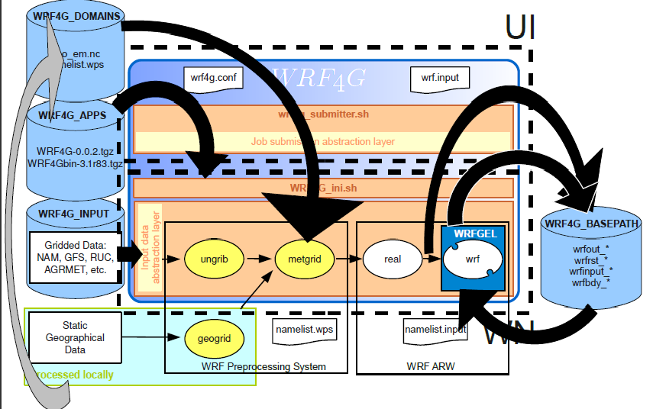
WRF4G

Slide 28
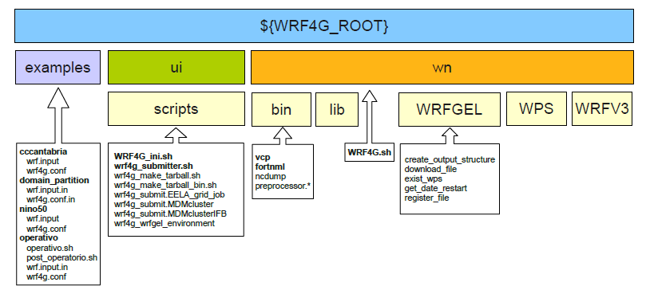
WRF4G

Slide 29
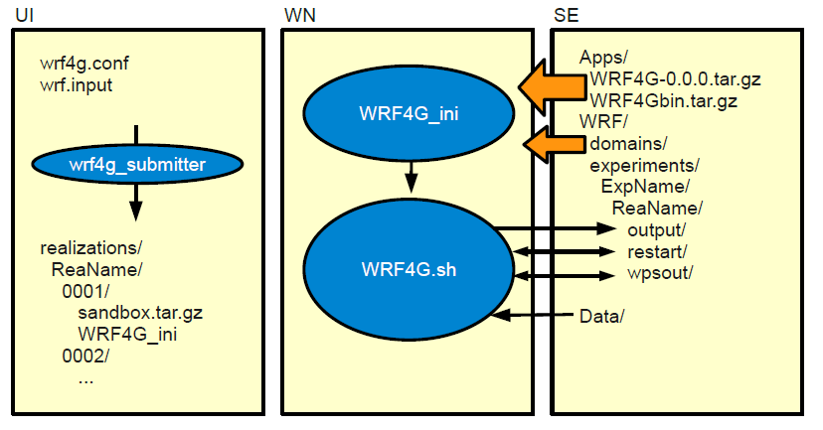
WRF4G

Slide 30
Outline
1
Background
2
Grid enabled GeoInformatics
3
VAST IOIT/ IAMI visit AIST/ ITRI for training
4
Discussion and Conclusion

Slide 31
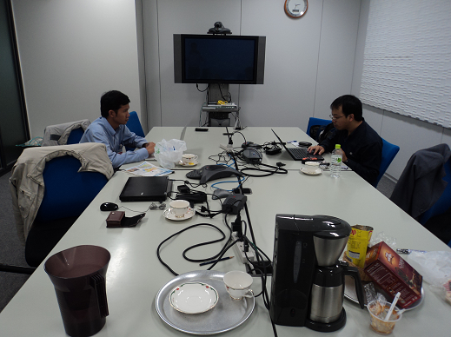
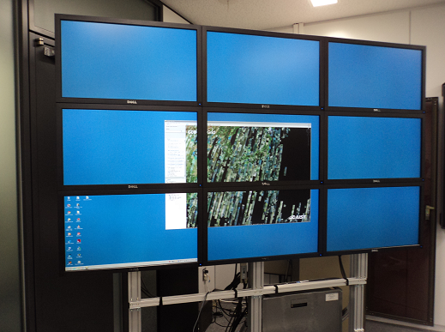
VAST IOIT/ IAMI (IT engineers) visit AIST/ ITRI
OCT 11- 13 training, OCT 14 Lab. Tour
AIST will send “ Packages to Learn” ‘
Area of study: Grid, Globus, OGC standards, Cloud/Virtualization, OS/ System software, Ninf-G (programming)
Application: What kind of application ?
Should be identified toward the Climate Change Program: Disaster mitigation, Weather Research and Forecasting for Grid (WRF4G),Natural resource discovery, Global warming.

Slide 32
VAST – AIST Bilateral workshop 2011
1st GeoGrid School in VAST for IT researcher
Lectures: Dr. Sato Sekiguchi, Dr. Yoshio Tanaka, and others
School In Hanoi:
Nov 28 (Monday) : Grid, Globus, OGC standards, Cloud/ Virtualization, OS/ System software
Nov 29 (Tuesday): Ninf- G, Middle ware deployment and development

Slide 33
VAST – AIST Bilateral workshop 2011
School In HoChiMinh city:
Nov 30 (Wednesday) : Grid, Globus, OGC standards, Cloud/ Virtualization, OS/ System software
Dec 01 (Tuesday): Ninf- G, Middleware deployment and development.

Slide 34
Outline
1
Background
2
Grid enabled Geoinformatics
3
VAST IOIT/ IAMI visit AIST/ ITRI for training
4
Discussion and Conclusion

Slide 35
Discussion
Computing Technology Research Center in VAST should be suggested in 2012.
Building the collaboration research in VAST ( IT & Geo Infrastructure) to find the solution to adapt with Climate Change in the Mekong Area.
More human power (IT & Application researcher of VAST ) in the CTRC for Geo GRID.
More application should be identified for approaching to Climate Change prediction in the Program of MOST in Vietnam. (R&D support by ITRI/ AIST)

Slide 36
Thank You for your attention

